Slide 1
Testimony to Senate Democratic Policy Committee Hearing
on Adult Use Cannabis in Pennsylvania:
Criminal Justice, Safety, and Economic Impacts
Oren M. Gur, Ph.D.
Director of DATA Lab & Research, Policy Advisor
District Attorney’s Transparency Analytics (DATA) Lab
Philadelphia District Attorney’s Office
DoubleTree by Hilton Hotel, Mastro Banquet Room
237 S. Broad Street
Philadelphia, PA 19107
September 25, 2026 at 1:00 p.m.

Slide 2
Outline
Local Context
Learning From Other States
  Criminal Justice Impact
  Safety Impact
  Economic Impact
Prevention: Three Critical Issues
  Revenue allocation
    Schools, transportation, housing, research
  Cash flow
  Consumer data

Slide 3
Local Context
Pennsylvania residents are already participating in a legal cannabis market — just not one that Pennsylvania taxes, regulates, or benefits from.
The Commonwealth can regulate local access responsibly rather than continuing to cede the market, the revenue, and the safety oversight to our neighbors.
  Nearly $5B in recreational sales in 2025 to NY, MD, DE, NJ, OH

Slide 4
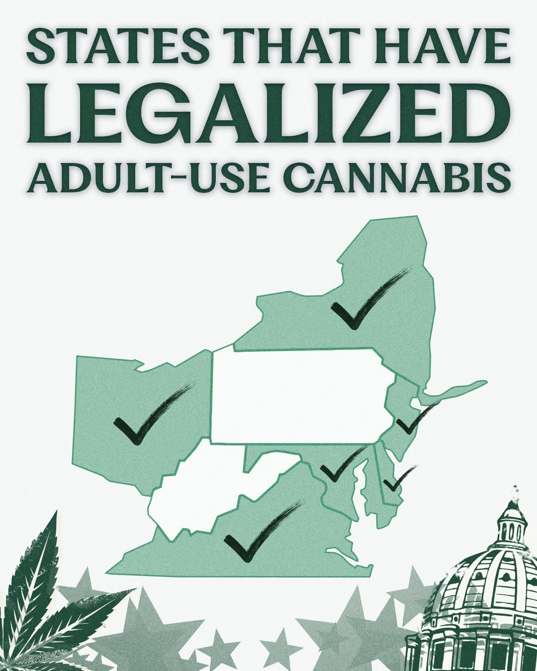
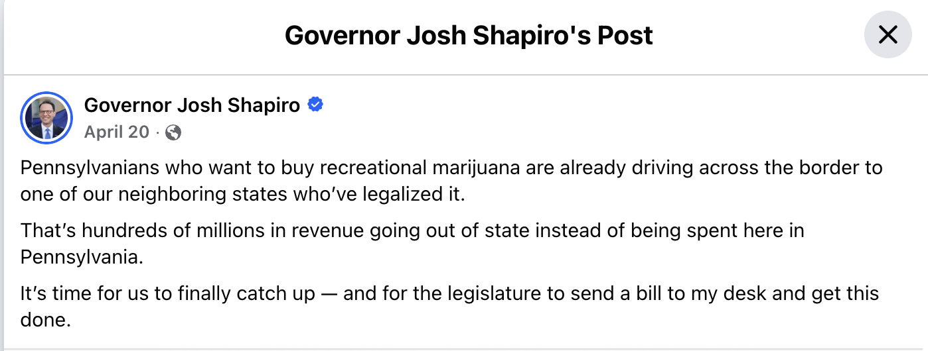
Local Context
Source: Gov. Josh Shapiro, Facebook post (2025)

Slide 5
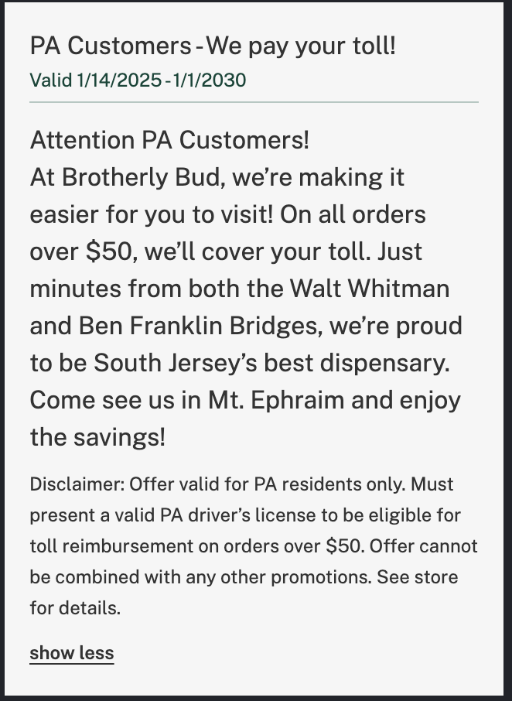
Local Context
Source: Leafly, “Brotherly Bud” dispensary listing (accessed 2026)

Slide 6
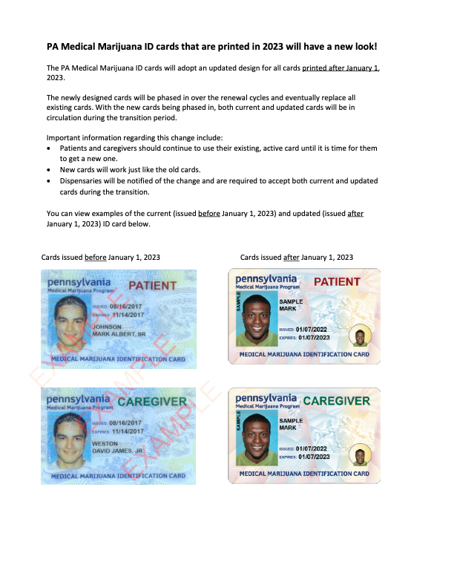
Local Context
Medical Marijuana in PA (as of 6/30/26):
  Nearly 439,000 Active Medical Marijuana Patients
  196 Dispensaries
  1,937 Approved Practitioners
  Total medical cannabis sales: nearly $1 billion
Notes:
Source: https://www.pa.gov/content/dam/copapwp-pagov/en/health/documents/topics/documents/programs/medical-marijuana/MM%20ID%20card%20New%20Look.pdf
https://themarijuanaherald.com/2026/07/pennsylvania-has-nearly-439000-active-medical-marijuana-patients-196-dispensaries-and-1937-approved-practitioners/

Slide 7
Criminal Justice
Impaired-driving standards
Automatic expungement, not petition-based relief
Retroactive relief for pending and past cases
Restorative reinvestment in communities most impacted by enforcement
Enforcement against unregulated stores and products
Notes:
Impaired-driving standards: There is no scientifically validated THC blood level that reliably tracks driving impairment. The AAA Foundation for Traffic Safety found no correlation between blood THC concentration and performance on standardized impairment tests, and recommended drug-recognition-trained officers over an arbitrary numeric threshold like Colorado and Washington's 5 ng/mL standard.
Source: AAA Foundation for Traffic Safety, “An Evaluation of Data from Drivers Arrested for Driving Under the Influence in Relation to Per Se Limits for Cannabis” (2016).
Automatic expungement, not petition-based relief: California's AB 1793 (2018) directed the state to identify and clear eligible cannabis convictions automatically, and Illinois has used a similar automatic process to expunge more than 500,000 low-level cannabis records — Pennsylvania's current Clean Slate and pardon pathways still require individuals to apply on their own.
Source: California Dept. of Justice, AB 1793 implementation reporting; Illinois State Police expungement data.
Retroactive relief for pending and past cases: New York's Marijuana Regulation and Taxation Act (2021) required courts to proactively identify and resentence or reseal cases for people still under supervision for conduct that became legal, not just those with closed convictions.
Source: New York Marijuana Regulation and Taxation Act (2021); N.Y. Office of Cannabis Management.
Restorative reinvestment in communities most impacted by enforcement: Illinois dedicates 25% of its adult-use cannabis tax revenue, on an ongoing basis, to its R3 (Restore, Reinvest, Renew) program, funding violence prevention and economic development in the neighborhoods most affected by past drug enforcement.
Source: Illinois Criminal Justice Information Authority, R3 Program.
Enforcement against unregulated stores and products: New York's slow licensed rollout paired with limited enforcement allowed thousands of unlicensed shops to open before a dedicated task force was created to close them. Pennsylvania is already seeing its own unregulated-market risk — see the following slide on Philadelphia smoke shops.
Source: N.Y. Office of Cannabis Management enforcement task force reporting; Marin & Briggs, The Philadelphia Inquirer (July 29, 2025).

Slide 8
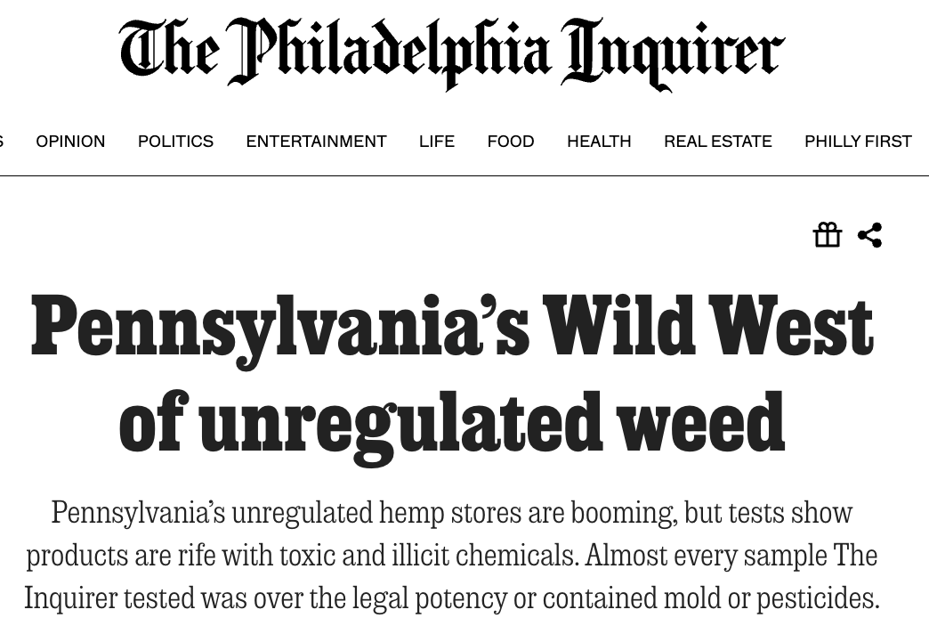
by Max Marin and Ryan W. Briggs
Published July 29, 2025, 5:00 a.m. ET
Notes:
Source: https://www.inquirer.com/news/a/pennsylvania-smoke-shops-weed-toxic-chemicals-mold-20250729.html#loaded

Slide 9
Safety
Dedicated Cannabis Control Board
Seed-to-sale tracking and mandatory lab testing
Opioid overdose deaths
Non-fatal overdoses
  Source: Prev Med Rep 2026;66:103497 (PMID 42181612)
Research on use by youth
Notes:
Dedicated Cannabis Control Board: New Jersey's Cannabis Regulatory Commission and Maryland's Cannabis Administration each consolidate licensing, compliance, and enforcement under one dedicated regulator rather than splitting authority across multiple existing agencies.
Source: N.J. Cannabis Regulatory Commission; Md. Cannabis Administration statutory authority.
Seed-to-sale tracking and mandatory lab testing: Colorado's statewide METRC tracking system, now used by most legal states, lets regulators audit cannabis products from cultivation through retail sale and is the backbone of the state's ability to keep untested product out of the legal market.
Source: Colorado Marijuana Enforcement Division, METRC system documentation.
Opioid overdose deaths: Early research linked medical cannabis laws to lower opioid overdose deaths, but a 2026 systematic review of the full literature found the evidence for both medical and recreational cannabis laws reducing opioid mortality is now inconsistent, and cautioned that legalization should not be treated as an effective opioid-epidemic policy.
Source: “Association between state cannabis laws and opioid outcomes: A systematic review,” Drug and Alcohol Dependence (2026), doi:10.1016/j.drugalcdep.2026.113167.
Non-fatal overdoses: Results: State MCDs and RCLs were associated with 15.47% (coefficient = -1.73; 95%CI: -2.72, -0.74) and 11.92% (coefficient = -1.33; 95%CI: -2.30, -0.37) reductions in non-fatal opioid poisonings per 100,000 enrollees per quarter, respectively. Reductions associated with MCDs were significant in ages 18-34, males and females, those without prescription opioids or cannabis use disorder diagnoses within the past year, and outpatient service users.
Source: “The association between state cannabis legalization and non-fatal opioid poisonings among adults with employer-sponsored insurance in the United States,” Prev Med Rep 2026;66:103497 (PMID 42181612).
Youth access: Colorado's 2025 Healthy Kids Colorado Survey found 9.7% of high schoolers reported past-30-day cannabis use, down from 12.8% in 2021 and a 56% drop from the pre-legalization 2011 baseline of 22% — consistent with national data showing no youth-use spike after legalization.
Source: Colorado Dept. of Public Health & Environment, Healthy Kids Colorado Survey results (press release, June 16, 2026).

Slide 10
Economic
Local control with a clear timeline
Small business and equity investment
Jobs and ancillary industry (see cash flow)
Revenue allocation for public priorities
Restorative reinvestment in communities most impacted by enforcement
Notes:
Local control with a clear timeline: Without a firm statewide deadline, California has seen roughly 60% of its cities and counties prohibit retail cannabis sales years after legalization, leaving large geographic gaps in legal access; Illinois and New Jersey set fixed opt-out windows instead, producing more even statewide coverage.
Source: California Dept. of Cannabis Control municipal data (Dec. 2023), via Cannabis Business Times.
Small business and equity investment: Illinois' early equity licensing rounds were delayed for years by litigation and capital-access bottlenecks. Massachusetts' Cannabis Social Equity Trust Fund — seeded with 15% of the state's Marijuana Regulation Fund revenue annually — pairs licensing preference with grants and low-interest loans to get equity applicants into operation.
Source: Massachusetts Cannabis Control Commission, Social Equity Program / Cannabis Social Equity Trust Fund (2022).
Jobs and ancillary industry (see cash flow): Michigan's adult-use market, built on comparable existing medical infrastructure, reported over $1.8 billion in adult-use sales in FY2022 alone, with revenue split 15% to municipalities, 15% to counties, 35% to the School Aid Fund, and 35% to the Transportation Fund — supporting jobs well beyond the cannabis industry itself.
Source: Michigan Cannabis Regulatory Agency, Marihuana Regulation Fund distributions; Michigan Regulation and Taxation of Marihuana Act (Initiated Law 1 of 2018).
Revenue allocation for public priorities: See the dedicated slides on schools, transportation, and research funding for how Colorado and Michigan structure this, and where Pennsylvania's current proposals fall short by comparison.
Source: Colorado Legislative Council Staff, “Update: Marijuana in the State Budget” (2025).
Restorative reinvestment in communities most impacted by enforcement: Illinois dedicates 25% of its adult-use cannabis tax revenue, on an ongoing basis, to its R3 program for violence prevention and economic development in the communities most affected by past drug enforcement — the same recurring, revenue-linked model recommended for Pennsylvania over a one-time appropriation.
Source: Illinois Criminal Justice Information Authority, R3 Program.

Slide 11
Prevention: Three Critical Issues
Revenue allocation for public priorities
  Schools
  Transportation infrastructure
  Housing
  Research
Cash-intensive operations and banking access
Consumer data protection

Slide 12
Revenue allocation for public priorities
Schools
  Colorado FY24-5: school funding “represent[ed] 33% of total marijuana distributions”
    Construction
      $40.1M in FY24-5 in Colorado
      “The first $40 million of excise tax revenue each year is constitutionally dedicated to school construction.”
    Programming, Personnel, etc.
      $43.2M in FY24-5 in Colorado
Source: Colorado Legislative Council Staff, “Update: Marijuana in the State Budget” (2025)
Notes:
https://content.leg.colorado.gov/sites/default/files/r25-569-update-marijuana-in-the-state-budget-memo-accessible.pdf

Slide 13
Revenue allocation for public priorities
Transportation infrastructure
  Road repair
  E.g., improved public transit should reduce risk of DUI
  E.g., targeted infrastructure improvements to improve road safety
  See Michigan marihuana revenue:
    35% to the Statewide School Aid Fund
    35% to the Michigan Transportation Fund
Notes:
https://content.leg.colorado.gov/sites/default/files/r25-569-update-marijuana-in-the-state-budget-memo-accessible.pdf
35% to the Statewide School Aid Fund
35% to the Michigan Transportation Fund

Slide 14
Revenue allocation for public priorities
Housing
  E.g., Illinois Restore, Reinvest, and Renew (R3) Program.
    Administered by the Illinois Criminal Justice Information Authority (ICJIA)
    Directly finance housing assistance, eviction defense, and community reentry housing
  E.g., Denver:
    “In 2018, City Council increased the special sales tax for retail marijuana from 3.5% to 5.5%. This 2% increase dedicated marijuana tax revenue to affordable housing programs.”
Source: Denver County Marijuana Data and Statistics (2026)
Notes:
https://www.denvergov.org/Government/Agencies-Departments-Offices/Agencies-Departments-Offices-Directory/Marijuana-information/Marijuana-data-and-statistics/Budget-and-expenditures

Slide 15
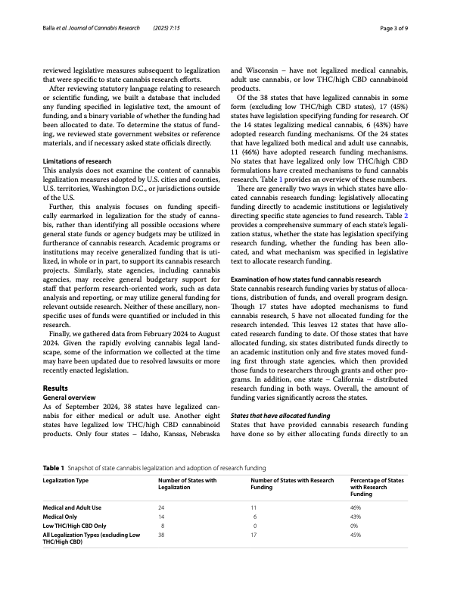
Revenue allocation for public priorities
Research
  Even after rescheduling, federal funding for cannabis research restricted to medical (https://www.congress.gov/crs-product/IF12715)
Balla et al. Journal of Cannabis Research https://doi.org/10.1186/s42238-025-00264-0 (2025) 7:15
Notes:
Balla et al. Journal of Cannabis Research https://doi.org/10.1186/s42238-025-00264-0
(2025) 7:15

Slide 16
Revenue allocation for public priorities
Research
  Examples funded by Colorado
    “Colorado Cannabis Research Consortium (C2RC): Research Program for the Management of Chronic Spine Pain and Reduction of Prescription Opioid Use”
    “A Randomized, Double-Blind, Placebo-Controlled Efficacy and Safety Study of Cannabidiol (CBD) for the Treatment of Irritability in Children and Adolescents with Autism Spectrum Disorder (ASD)”
    “The Long-Term, Prospective, Therapeutic Impact of Cannabis on Post-Traumatic Stress Disorder”
    Rigorous research on epilepsy, PTSD, pain, sleep, health impacts, more
Source: Colorado Dept. of Public Health & Environment, press release (2025)
Notes:
https://cdphe.colorado.gov/press-release/state-issues-27-million-in-medical-marijuana-research-grants
Participants who used cannabis were 2.57 times more likely to no longer meet DSM-5 criteria for PTSD at the end of the study observation period *1 year) compared to participants who did not use cannabis (95% CI=1.12–6.07; p=0.03).
https://pmc.ncbi.nlm.nih.gov/articles/PMC9070744/

Slide 17
Revenue allocation for public priorities
Research
  PA has research model for medical marijuana
    10 Certified Medical Marijuana Academic Clinical Research Centers
      Hershey, Pittsburgh, Erie, Scranton, Philadelphia
    50 funded research studies, e.g.:
      Cannabis and Cannabis Derivatives for Abdominal Pain Management in Inflammatory Bowel Disease
      Motivation and experiences of individuals with opioid use disorder and chronic pain using medical cannabis for 12 months
      Anxiety severity and prescription medication utilization in first-time medical marijuana users
Source: PA Department of Health, Medical Marijuana Clinical Research Program
Notes:
https://cdphe.colorado.gov/press-release/state-issues-27-million-in-medical-marijuana-research-grants
Motivation and experiences of individuals with opioid use disorder and chronic pain using medical cannabis for 12 months
Anxiety severity and prescription medication utilization in first-time medical marijuana users

Slide 18
Prevention: Three Critical Issues
Cash-intensive operations and banking access
  Federally insured banks and major credit-card networks restrictions
  Risk of burglary and robbery
    Mandate cash-security standards; helps create jobs for veterans
  State-chartered credit unions serve licensed operators in many states
    e.g., PA medical marijuana businesses work with Colorado's Safe Harbor Financial
  Act 108 of 2022 good start; Colorado goes further
    Permission vs. TA
    Colorado Division of Banking: "Roadmap to Cannabis Banking”: TA for state-chartered banks and credit unions to serve cannabis businesses
Source: Colorado Division of Banking, “Roadmap to Cannabis Banking” (2020)
Notes:
https://cdphe.colorado.gov/press-release/state-issues-27-million-in-medical-marijuana-research-grants
Motivation and experiences of individuals with opioid use disorder and chronic pain using medical cannabis for 12 months
Anxiety severity and prescription medication utilization in first-time medical marijuana users
Iron Protection Group, founded by Marine combat veterans, and Helix TCS, whose security staff is roughly 95% veterans,

Slide 19
Prevention: Three Critical Issues
Consumer data protection
  Unique from medical marijuana data, which is statutorily protected by Department of Health
  Need protections for point-of-sale systems
    Examples of breaches of private vendor POS system:
      2016 and 2017 (2x), MJ Freeway, individual level info, system offline
      2020, THSuite, 85,000 files with full names, DOBs, signatures, etc.
    Structural issue: forced to work with emergent vendors
  Data retention, sharing, selling beyond what compliance requires
    Specific statues in Oregon, Alaska, and Colorado vs. general consumer protections
Notes:
2020, THSuite, a point-of-sale platform used by dispensaries nationally, suffered a breach exposing roughly 85,000 files containing customers' full names, dates of birth, phone numbers, emails, addresses, signatures, the specific products and quantities they purchased, how much they spent, transaction dates, and, for medical patients, their medical ID numbers

Slide 20
Outline
Local Context
Learning From Other States
  Criminal Justice Impact
  Safety Impact
  Economic Impact
Prevention: Three Critical Issues
  Revenue allocation
    Schools, transportation, housing, research
  Cash flow
  Consumer data

Slide 21
Thank You!
Oren M. Gur, Ph.D.
Director of DATA Lab & Research, Policy Advisor
District Attorney’s Transparency Analytics (DATA) Lab
Philadelphia District Attorney’s Office
Oren.Gur@Phila.Gov

Slide 22
Extra slide(s)

